Slide 1
102B Pilot Study
CHINWAG
Emma Bergman, Christian Gutierrez, Peter Louden, Cassie Qiu

Slide 2
In the Literature
Notes:
Emma

Slide 3
In the Literature
What purpose do compliments serve in conversation? (H1)
Notes:
Emma

Slide 4
In the Literature
What purpose do compliments serve in conversation? (H1)
How does perceived attractiveness influence social interaction? (HA)
Notes:
Emma

Slide 5
In the Literature
What purpose do compliments serve in conversation? (H1)
How does perceived attractiveness influence social interaction? (HA)
The Solidarity Hypothesis (Wolfsan & Manes; 1980)
Compliments are used to create a sense of solidarity (positive bond) between interlocutors.
Notes:
Emma

Slide 6
In the Literature
What purpose do compliments serve in conversation? (H1)
How does perceived attractiveness influence social interaction? (HA)
The Solidarity Hypothesis (Wolfsan & Manes; 1980)
Compliments are used to create a sense of solidarity (positive bond) between interlocutors.
The Face Threatening Acts Hypothesis (Holmes; 1986)
Compliments are only superficially positive and are often accompanied by criticism or requests or can be perceived as an expression of envy/desire for what the other has.
Compliments as a strategy to increase compliance of requests (Grant, Fabrigar, Lim; 2010)
Notes:
Emma

Slide 7
In the Literature
What purpose do compliments serve in conversation? (H1)
How does perceived attractiveness influence social interaction? (HA)
The Solidarity Hypothesis (Wolfsan & Manes; 1980)
Compliments are used to create a sense of solidarity (positive bond) between interlocutors.
The Face Threatening Acts Hypothesis (Holmes; 1986)
Compliments are only superficially positive and are often accompanied by criticism or requests or can be perceived as an expression of envy/desire for what the other has.
Compliments as a strategy to increase compliance of requests (Grant, Fabrigar, Lim; 2010)
First Impressions (Willis & Todorov; 2006)
Judgments regarding “attractiveness, likeability, trustworthiness” etc are made within the first 100ms of exposure to a face
Notes:
Emma

Slide 8
Goals/Hypotheses
Notes:
Cassie

Slide 9
Goals/Hypotheses
H1: The use of a non-personal compliment about superficial appearance or characteristics when first meeting a stranger of the opposite gender is effective in eliciting additional (comparably more) engagement (gestures, (non)verbal affirmations) or positive affect(smiling, laughing, open body language) over the course of an introductory conversation.
Notes:
Cassie

Slide 10
Goals/Hypotheses
H1: The use of a non-personal compliment about superficial appearance or characteristics when first meeting a stranger of the opposite gender is effective in eliciting additional (comparably more) engagement (gestures, (non)verbal affirmations) or positive affect(smiling, laughing, open body language) over the course of an introductory conversation.
H0: The use of a non-personal compliment about superficial appearance or characteristics when first meeting a stranger of the opposite gender is ineffective in eliciting additional (comparably more) engagement or positive affect* over the course of an introductory conversation.
Notes:
Cassie

Slide 11
Goals/Hypotheses
H1: The use of a non-personal compliment about superficial appearance or characteristics when first meeting a stranger of the opposite gender is effective in eliciting additional (comparably more) engagement (gestures, (non)verbal affirmations) or positive affect(smiling, laughing, open body language) over the course of an introductory conversation.
H0: The use of a non-personal compliment about superficial appearance or characteristics when first meeting a stranger of the opposite gender is ineffective in eliciting additional (comparably more) engagement or positive affect* over the course of an introductory conversation.
H-Alternative: Rather than the use of a compliment, perceived attractiveness of the conversational partner will have the greatest impact on the relative engagement or positive affect among strangers.
Notes:
Cassie

Slide 12
The CHINWAG Approach
Notes:
Christian

Slide 13
The CHINWAG Approach
Multi Party - Two participants per trial
Compliment condition balanced for gender
Notes:
Christian

Slide 14
The CHINWAG Approach
Multi Party - Two participants per trial
Compliment condition balanced for gender
Multi Modal - Compliment/no compliment; Gaze; Laughter; Smiling; Gesture; perception
How does the use of a compliment impact social cues such as laughter and gaze IN ADDITION to perception (questionnaire responses)
Notes:
Christian

Slide 15
The CHINWAG Approach
Multi Party - Two participants per trial
Compliment condition balanced for gender
Multi Modal - Compliment/no compliment; Gaze; Laughter; Smiling; Gesture; perception
How does the use of a compliment impact social cues such as laughter and gaze IN ADDITION to perception (questionnaire responses)
Only recognize physical, observable nuances in the participants’ interactions
Positive emotes are further broken down into level of emotional commitment
Head nodding, smiling, laughing
Notes:
Christian

Slide 16
The CHINWAG Approach
Multi Scalar
Notes:
Peter

Slide 17
The CHINWAG Approach
Multi Scalar
Micro: Tracking of changes in position and expression on the scale of milliseconds
Notes:
Peter

Slide 18
The CHINWAG Approach
Multi Scalar
Micro: Tracking of changes in position and expression on the scale of milliseconds
Macro: Participants’ attitude toward and evaluation of each other indicated by their behavior during the conversation and recorded in their interview responses
Notes:
Peter

Slide 19
The CHINWAG Approach
Multi Scalar
Micro: Tracking of changes in position and expression on the scale of milliseconds
Macro: Participants’ attitude toward and evaluation of each other indicated by their behavior during the conversation and recorded in their interview responses
Historic: Social conventions concerning how to approach an initial interaction with a stranger
e.g. attentiveness, subject matter, personal space, use of compliments
Notes:
Peter

Slide 20
Methods:
Notes:
Emma: We’re using a quasi-experimental method. For condition 1, one participant is instructed to compliment the other in the beginning of the conversation. Both participants are instructed to get to know each other over the course of a ten minute conversation sitting on a couch. In condition 2, there is no instruction to compliment.

Slide 21
Methods:
Participants: single heterosexual UCSD students aged 19-21 years; 10 Males; 10 Females
Notes:
Emma: We’re using a quasi-experimental method. For condition 1, one participant is instructed to compliment the other in the beginning of the conversation. Both participants are instructed to get to know each other over the course of a ten minute conversation sitting on a couch. In condition 2, there is no instruction to compliment.

Slide 22
Methods:
Participants: single heterosexual UCSD students aged 19-21 years; 10 Males; 10 Females
Materials: Couch, Camera (1 facing couch), Questionnaires
Notes:
Emma: We’re using a quasi-experimental method. For condition 1, one participant is instructed to compliment the other in the beginning of the conversation. Both participants are instructed to get to know each other over the course of a ten minute conversation sitting on a couch. In condition 2, there is no instruction to compliment.

Slide 23
Methods:
Participants: single heterosexual UCSD students aged 19-21 years; 10 Males; 10 Females
Materials: Couch, Camera (1 facing couch), Questionnaires
Condition 1: One participant is instructed to compliment their conversational partner at the beginning of the conversation. Both participants are told to converse and get to know each other over the course of ten minutes and then asked to fill out a written questionnaire (short answer and number scales)
Notes:
Emma: We’re using a quasi-experimental method. For condition 1, one participant is instructed to compliment the other in the beginning of the conversation. Both participants are instructed to get to know each other over the course of a ten minute conversation sitting on a couch. In condition 2, there is no instruction to compliment.

Slide 24
Methods:
Participants: single heterosexual UCSD students aged 19-21 years; 10 Males; 10 Females
Materials: Couch, Camera (1 facing couch), Questionnaires
Condition 1: One participant is instructed to compliment their conversational partner at the beginning of the conversation. Both participants are told to converse and get to know each other over the course of ten minutes and then asked to fill out a written questionnaire (short answer and number scales)
Condition 2: Both participants are told to converse and get to know each other over the course of ten minutes and then asked to fill out a written questionnaire (short answer and number scales)
Notes:
Emma: We’re using a quasi-experimental method. For condition 1, one participant is instructed to compliment the other in the beginning of the conversation. Both participants are instructed to get to know each other over the course of a ten minute conversation sitting on a couch. In condition 2, there is no instruction to compliment.

Slide 25
Tiers - for males and females
Gaze | Looking towards/away from partner
Verbal | Verbal affirmations (not in response to questions) Laughter
Body orientation | Angled towards/away
Head | Nods of affirmation (not in response to questions)
Positive Emotes | Smiling
Hands | Duration of gesture Closed or open when at rest
Questionnaire Responses | Sexual orientation, perceived attraction, enjoyment of conversation
Notes:
Cassie

Slide 26
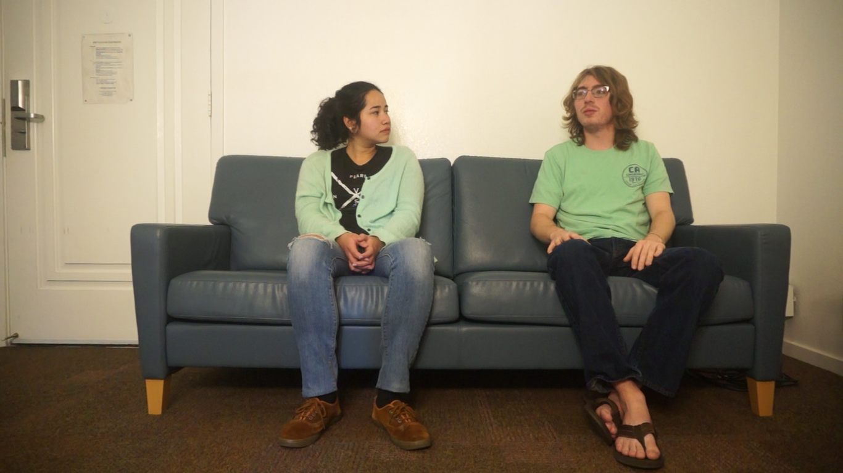
Gaze oriented
away
Gaze oriented
towards
Hands open
Hands crossed
Legs open and oriented away
Legs crossed
Notes:
Peter

Slide 27
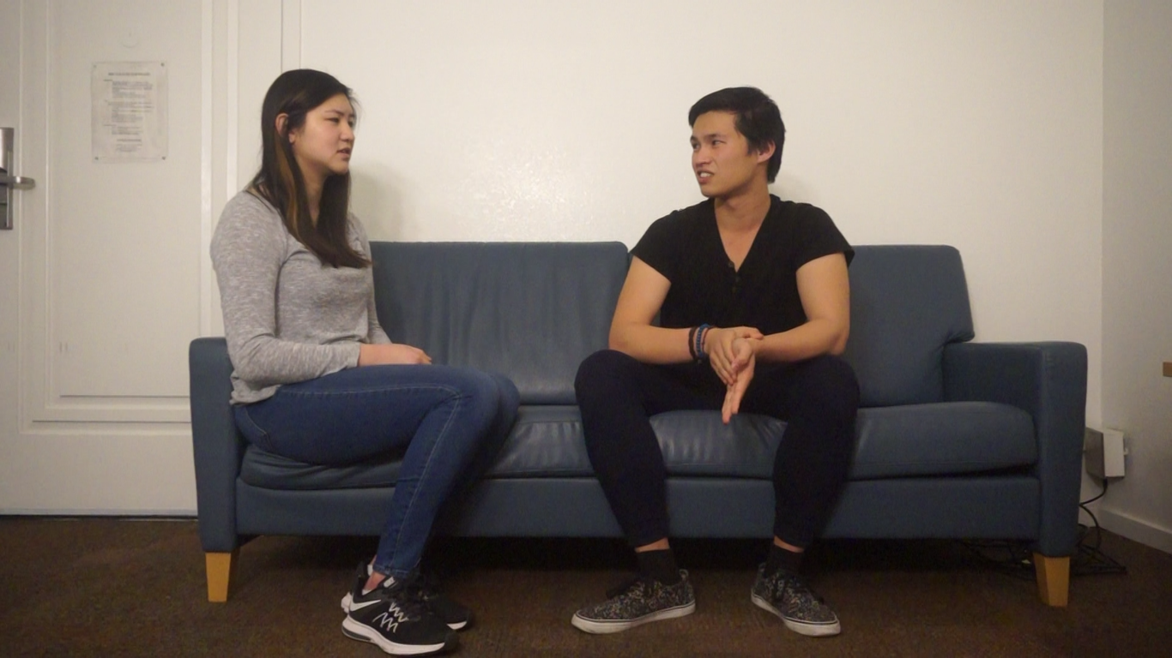
{
Whole body
oriented towards
Notes:
Peter

Slide 28
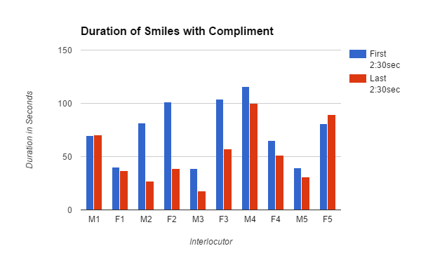
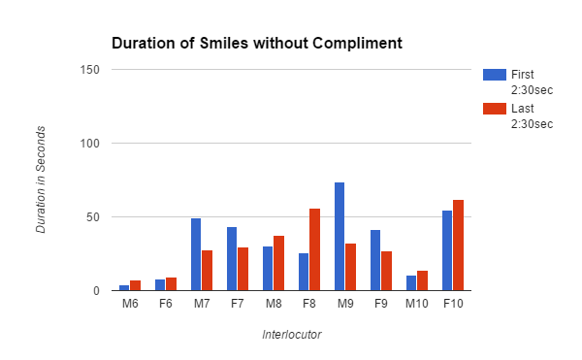
More Smiling in Compliment Condition
Typically More Smiling During the First 2min 30sec
Notes:
Most Smiling during first 2:30 of Compliment Cond.

Slide 29
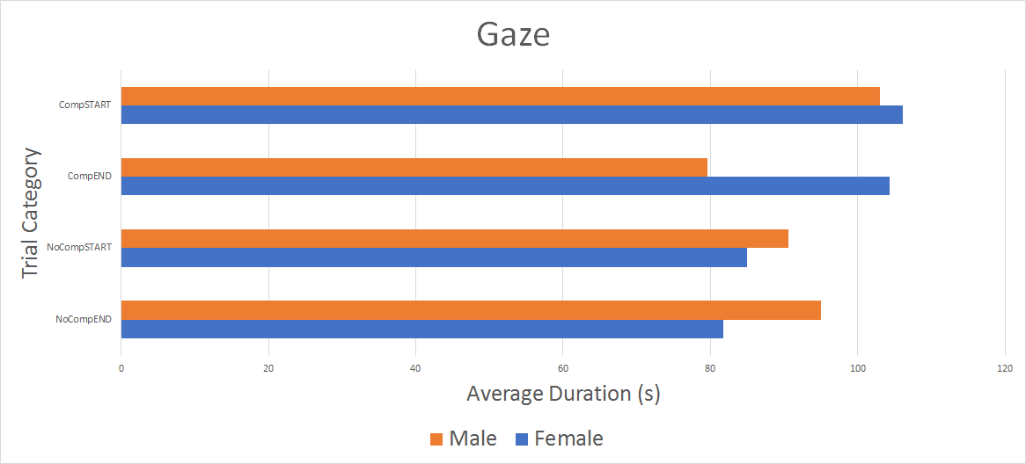
Gaze towards more in compliment condition
Notes:
Gaze towards

Slide 30
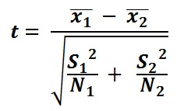
t-test
Average smiling time in each trial
 | Compliment | No Compliment
mean(s) | 251.350 | 146.325
sd(s) | 47.127 | 21.136
T-value = 5.57527
p- value < 0.01
Significant!
Average gaze towards time
 | Compliment | No Compliment
mean(s) | 393.058 | 352.418
sd(s) | 43.727 | 23.713
T-value = 2.473476
p- value < 0.05
Significant!

Slide 31
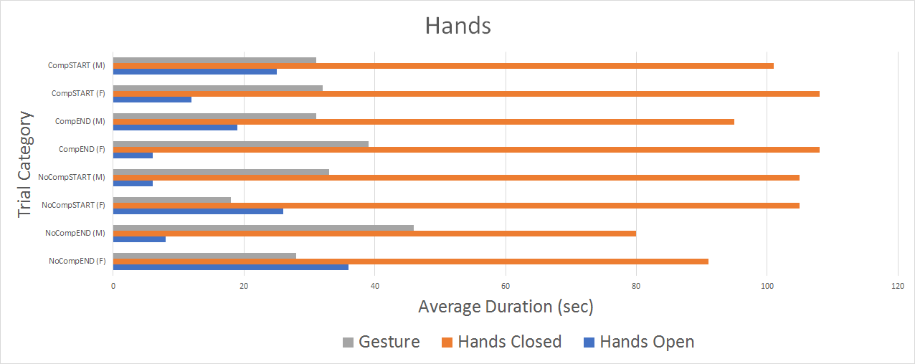
No significant findings for hand modality

Slide 32
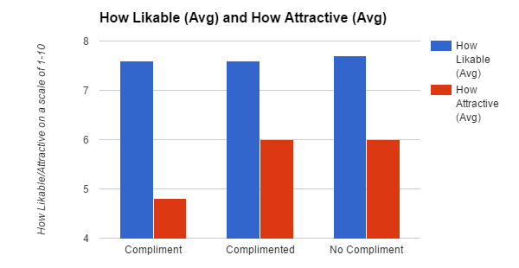
No Observed Compliment Effect on Liking
Compliment givers rate receivers as less attractive?

Slide 33
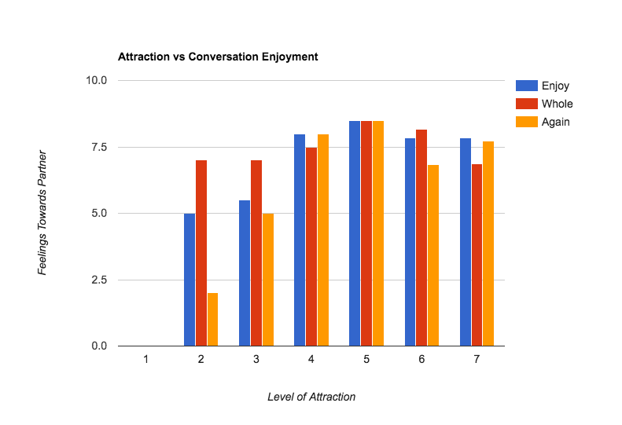
Does physical attraction affect how you feel about strangers?
Notes:
Christian

Slide 34
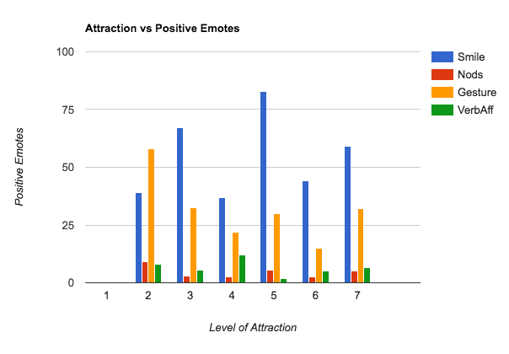
Does physical attraction affect how you react to strangers?
Notes:
Christian

Slide 35
Discussion

Slide 36
Discussion
How do compliments influence social situations? (H1)

Slide 37
Discussion
How do compliments influence social situations? (H1)
Increased smiling - especially during the first 2:30 when the compliment occurred

Slide 38
Discussion
How do compliments influence social situations? (H1)
Increased smiling - especially during the first 2:30 when the compliment occurred
Increased gaze towards

Slide 39
Discussion
How do compliments influence social situations? (H1)
Increased smiling - especially during the first 2:30 when the compliment occurred
Increased gaze towards
Compliment givers tend to rate their conversational partners as less attractive
Confounded by the requirement to compliment?

Slide 40
Discussion (cont.)
How does perceived attractiveness influence social interaction? (HA)

Slide 41
Discussion (cont.)
How does perceived attractiveness influence social interaction? (HA)
Overly low and overly high attraction levels correlate with
Lower levels of enjoyment
Lower participant attachment
Less favorable perception of the conversation

Slide 42
Discussion (cont.)
How does perceived attractiveness influence social interaction? (HA)
Overly low and overly high attraction levels correlate with
Lower levels of enjoyment
Lower participant attachment
Less favorable perception of the conversation
Those with attraction scores of 5/10 had the highest levels of social scoring in all trials
People with average looks have better personalities?

Slide 43
Critique

Slide 44
Critique
During conversation, participants referred to the camera or commented on how artificial the situation seemed

Slide 45
Critique
During conversation, participants referred to the camera or commented on how artificial the situation seemed
10 minute conversation may have been unnaturally long

Slide 46
Critique
During conversation, participants referred to the camera or commented on how artificial the situation seemed
10 minute conversation may have been unnaturally long
Use more than one camera to accurately track gaze and smiles

Slide 47
Critique
During conversation, participants referred to the camera or commented on how artificial the situation seemed
10 minute conversation may have been unnaturally long
Use more than one camera to accurately track gaze and smiles
Chosen coded behaviors may not be ideal indicators of attitude

Slide 48
Critique (cont.)
Track the duration of participant speech

Slide 49
Critique (cont.)
Track the duration of participant speech
Observe compliments in natural situations rather than requiring one participant to compliment the other for greater validity

Slide 50
Critique (cont.)
Track the duration of participant speech
Observe compliments in natural situations rather than requiring one participant to compliment the other for greater validity
More participants

Slide 51
Critique (cont.)
Track the duration of participant speech
Observe compliments in natural situations rather than requiring one participant to compliment the other for greater validity
More participants
Separate condition(s) for Male/Female compliment giver/receiver

Slide 52
Thank You

